Slide 1
Genome Update
Shannon EK Joslin
GVL Lab Meeting
03 March 2021

Slide 2
outline
sequencing technologies
pipeline
current status
future use
genome
pipeline

Slide 3
terms
N50 – the LENGTH of contigs/scaffolds that contain 50% or more of the assembly
L50 – the NUMBER of contigs/scaffolds that contain 50% or more of the assembly
length = 20
length = 15
length = 10
…
N50 = 10
L50 = 3

Slide 4
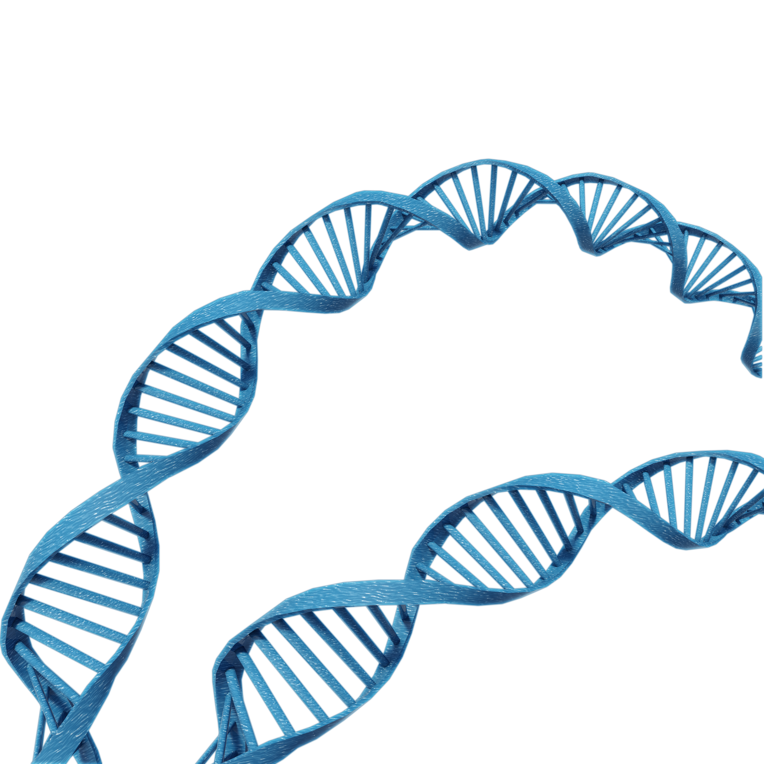
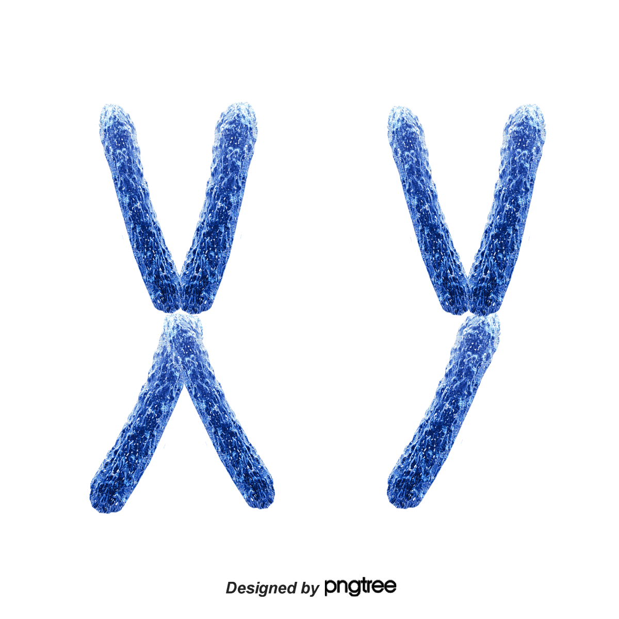
hybrid assembly
uses multiple sequencing technologies
each technology captures sequence data in different ways
long reads
hi-c
A
T
T
C
G
T
C
G
A
C
C
G
G
T
A
A
C
G
A
A
linked reads
Notes:
Now that we know the number of chromosomes we need to assemble let talk about how to do that. The best way to obtain a high quality assembly is by using multiple types of sequencing technologies. These technologies diversify how and what sequences you can capture and assemble. Long reads will span a relatively long distance, so they may capture entire chapters in a volume. However, they are quite error prone so one in every twenty words may be wrong. Linked reads are shorter and more accurate, so they will give you a series of sentences and say the sentences all come from a particular chapter. We can use these reads to correct the errors in the long reads. Hi-c will tell you where the chapter lie in relation to one another. For example, if you think about the example of an encyclopedia hi-c would tell you that the B section is always surrounded by the A section and the C section.

Slide 5
workflow #1
linked reads + hi-c
Sequencing
Initial Assembly
Sequencing
Scaffolding
…
Sample
HMW gDNA extraction
Linked-Read
(10X)
Genome!
Supernova
Hi-C
Lachesis
+
+
assembly metrics
assembly metrics

Slide 6
workflow #1
poor assembly metrics
Sequencing
Initial Assembly
Sequencing
Scaffolding
…
Sample
HMW gDNA extraction
Linked-Read
(10X)
Genome!
Supernova
Hi-C
Lachesis
+
+
assembly metrics
assembly metrics

Slide 7
workflow #2
add in long reads
Initial Assembly
Sequencing
Add in sequencing technology
More sequencing
Scaffold
Scaffold
Sample
HMW gDNA extraction
FALCON
Genome!
Long Reads
(PacBio)
10X
scaff10x
Phase
SALSA
Canu
+
+
+
assembly metrics
assembly metrics
assembly metrics

Slide 8
workflow #2
couldn’t get FALCON to reliably run on the farm
Initial Assembly
Sequencing
Add in sequencing technology
More sequencing
Scaffold
Scaffold
Sample
HMW gDNA extraction
FALCON
Genome!
Long Reads
(PacBio)
10X
scaff10x
Phase
SALSA
Canu
+
+
+
assembly metrics
assembly metrics
assembly metrics

Slide 9
workflow #2
assembly metrics were trash
Sequencing
Initial Assembly
Add in sequencing technology
More sequencing
Scaffold
Scaffold
Sample
HMW gDNA extraction
Genome!
Long Reads
(PacBio)
canu + purge_dups
10X
scaff10x
Phase
SALSA
+
+
+
assembly metrics
assembly metrics
assembly metrics

Slide 10
workflow #2
a new long read assembler just came out
Sequencing
Initial Assembly
Add in sequencing technology
More sequencing
Scaffold
Scaffold
Sample
HMW gDNA extraction
Genome!
Long Reads
(PacBio)
?
ipa
10X
scaff10x
Phase
SALSA
+
+
+
assembly metrics
assembly metrics
assembly metrics

Slide 11
workflow #2
assembly metrics were better but not great
Sequencing
Initial Assembly
Add in sequencing technology
More sequencing
Scaffold
Scaffold
Sample
HMW gDNA extraction
Genome!
Long Reads
(PacBio)
?
ipa
10X
scaff10x
Phase
SALSA
+
+
+
assembly metrics
No…
assembly metrics
assembly metrics

Slide 12
workflow #2
incorporated linkage map data to close gaps
assembly metrics
Sequencing
Initial Assembly
Add in sequencing technology
+
Scaffold
More sequencing
Scaffold
Linkage Map
Sample
HMW gDNA extraction
Long Reads
(PacBio)
ipa
10X
scaff10x
Phase
SALSA
chromonomer
+
+
+
assembly metrics
assembly metrics
assembly metrics
Genome
?

Slide 13
workflow #2
success!
assembly metrics
Sequencing
Initial Assembly
Add in sequencing technology
+
Scaffold
More sequencing
Scaffold
Linkage Map
Sample
HMW gDNA extraction
Long Reads
(PacBio)
ipa
10X
scaff10x
Phase
SALSA
chromonomer
+
+
+
assembly metrics
assembly metrics
assembly metrics
Genome
!

